Slide 1


#LifeKoKaroLift
Algorithms

Slide 2



Module Name - Algorithms
Class - Day 9
Instructor- Rahul Kumar
EditEdit MasterMaster texttext stylesstyles

Slide 3

Today’s Agenda
· Parameters of Algorithm Efficiency
· Complexity functions
· Asymptotic notations
· Big O functions
· Time vs Space complexity trade off
· Run time analysis of various algorithms
· Fibonacci sequence
· Recursion

Slide 4

Parameters Of Algorithmic Efficiency
What about searching for a particular book from a pile of books arranged alphabetically?
Suppose we wish to find the book “How to overcome the fear of coding?”
Should we start looking from the beginning of the alphabet, i.e. letter “A”?
Or should we start looking directly from the letter “H”?
Which searching ALGORITHM seems to be more EFFICIENT?
Image id: 511697149

Slide 5
Parameters Of Algorithmic Efficiency
There are 2 parameters that define the efficiency of an algorithm:
Time Taken
Memory space
Both of these parameters are calculated as a function of the input size, which is usually denoted by the variable ‘n’.
We tend to consider the worst case, i.e. the specific case in which the instruction set is executed a maximum number of times.
There are three cases in the analysis of an algorithm:
Best case
Average case
Worst case

Slide 6
Parameters Of Algorithmic Efficiency
Best Case
When the element to be searched is present at the first position
1 | 7 | 4 | 9 | 2 | 8 | 6 | 3 | 5
How many iterations will it take if we search for 1?

Slide 7
Parameters Of Algorithmic Efficiency
Worst Case
When the element to be searched is present at the last position
When the element to be searched is not present
1 | 7 | 4 | 9 | 2 | 8 | 6 | 3 | 5
How many iterations will it take if we search for 5?
Is it equal to the number of iterations taken to search 0 in the array?

Slide 8
Parameters Of Algorithmic Efficiency
Average Case
Consider all possible different types of input data and calculate the time taken for all those inputs
Find the arithmetic mean of all times. The obtained value is the time taken in the average case.
1 | 7 | 4 | 9 | 2 | 8 | 6 | 3 | 5
Can you find the exact value of the average number of iterations?
If the array size is N, can you find a general formula for the average number of iterations using this algorithm?

Slide 9
Complexity Functions
Look at these two code snippets to find the duplicate IDs in an array:
for (int i = 0; i < id.length; i++) {
for (int j = i+1; j < id.length; j++){
if (id[i] == id[j]) {
System.out.print(id[i] + " ");
break; }}}
for (int i = 0; i < id.length; i++){
count[id[i]]++;
if (count[id[i]] == 2){
System.out.print(id[i] + " ");
}
System.out.println(); }
SNIPPET 1
SNIPPET 2
Can you find the time and space complexity of both these snippets?
Can we say that one algorithm is better than the other?
Notes:
Explain explicitly the importance of break statement in snippet 1 and count==2 condition in snippet 2 which performs the same function.

Slide 10
Complexity Functions
for (int i = 0; i < id.length; i++) {
for (int j = i+1; j < id.length; j++){
if (id[i] == id[j]) {
System.out.print(id[i] + " ");
break; }}}
SNIPPET 1
Time complexity:
T(n) = C1 + 𝑛(𝑛−1) / 2 * C2 ⇒ T(n ) ∈ O(𝑛² ) – Quadratic function
Space complexity:
S(n ) ∈ O(1) – Constant function
Notes:
Explain explicitly the importance of break statement in snippet 1 and count==2 condition in snippet 2 which performs the same function.

Slide 11
Complexity Functions
for (int i = 0; i < id.length; i++){
count[id[i]]++;
if (count[id[i]] == 2){
System.out.print(id[i] + " ");
}
System.out.println(); }
SNIPPET 2
Time complexity:
T(n) = C1 + n* C2 ⇒ T(n) ∈ O(𝑛) – Linear function
Space complexity:
S(n) ∈ O(n) – Linear function
Notes:
Explain explicitly the importance of break statement in snippet 1 and count==2 condition in snippet 2 which performs the same function.

Slide 12
Asymptotic Notations
Asymptotic notations are standard notations used to express time and space complexity of any algorithm
Three types of asymptotic notations are most commonly used:
Big O (O)
Big Omega (Ω)
Big Theta (θ)

Slide 13
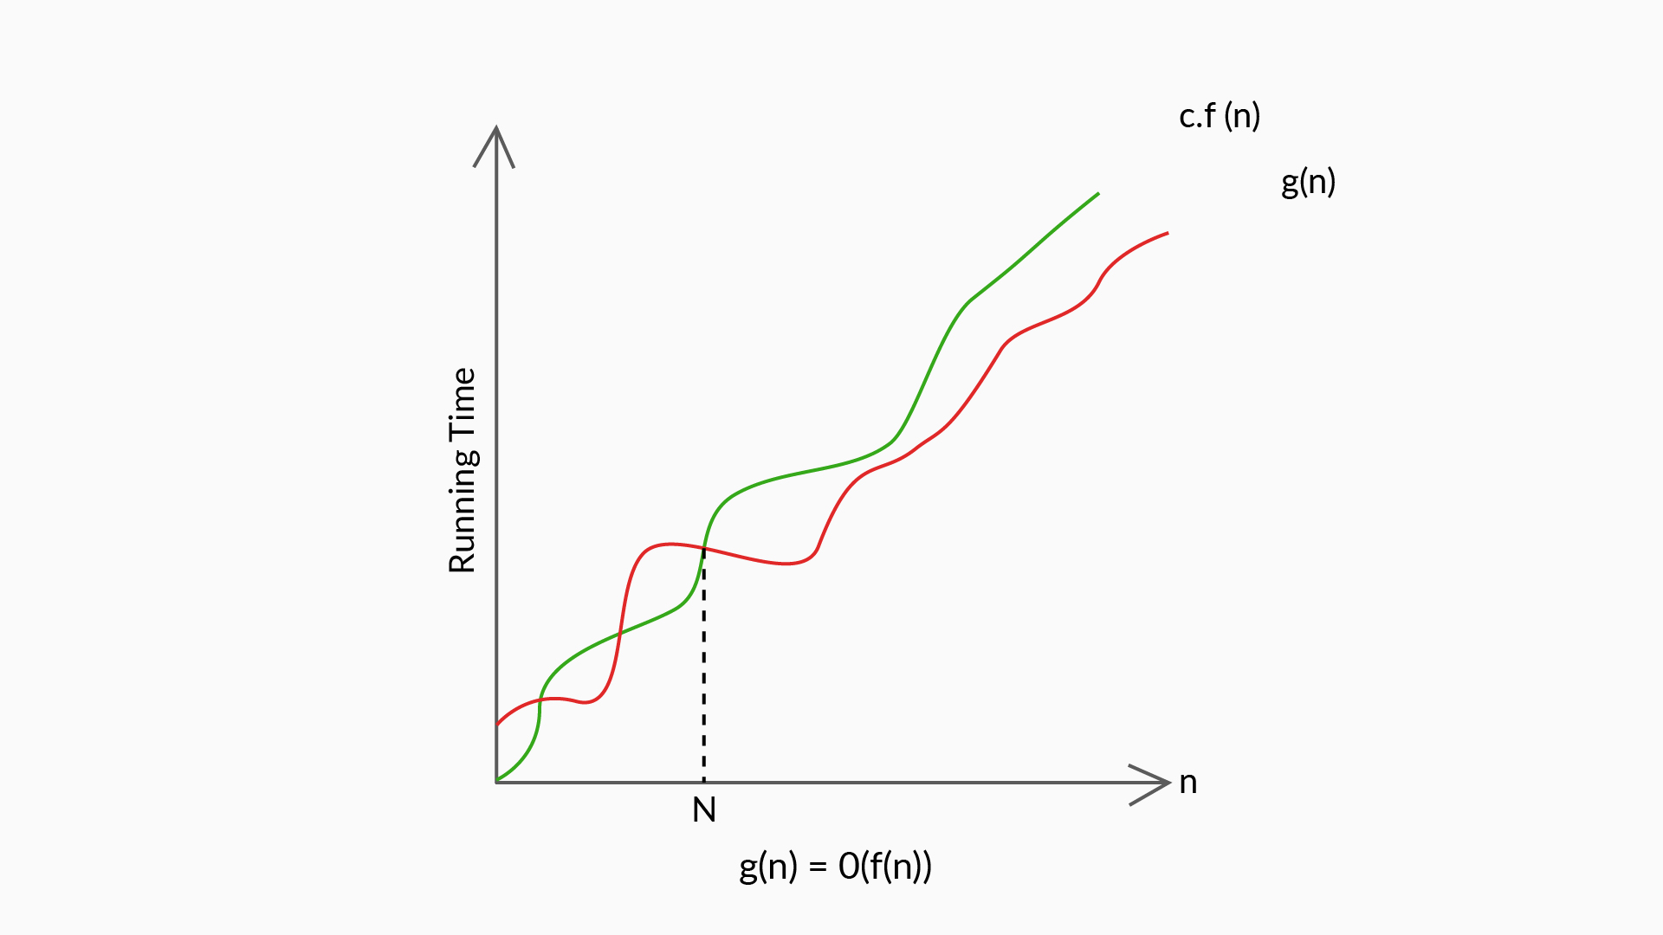
Asymptotic Notations
Big O(O)
Big O indicates the upper bound of the running time of an algorithm
When calculating Big O, the time complexity function of an algorithm is lower than or equal to the upper bound
The most frequently used notation to find complexity functions

Slide 14
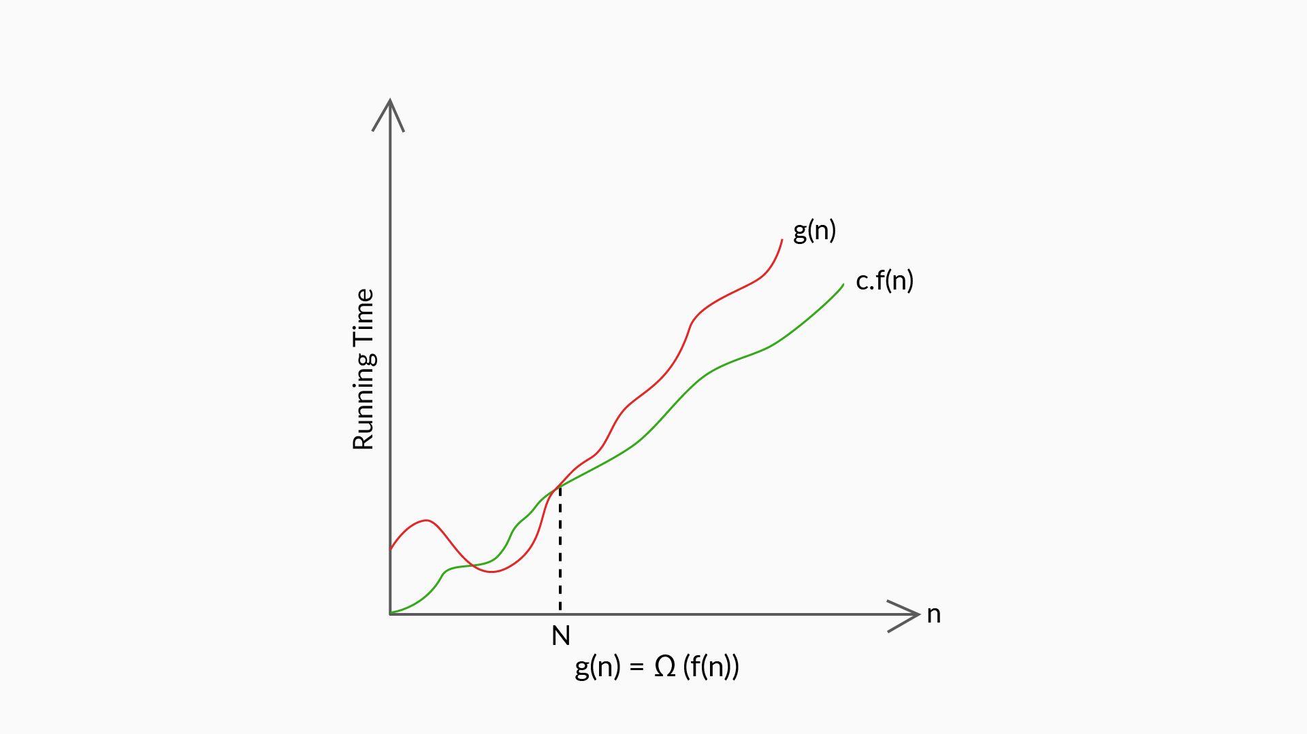
Asymptotic Notations
Big Omega(Ω)
Big Omega indicates the lower bound of the running time of an algorithm
When calculating Big Omega, the time complexity function of an algorithm is higher than or equal to the lower bound.

Slide 15
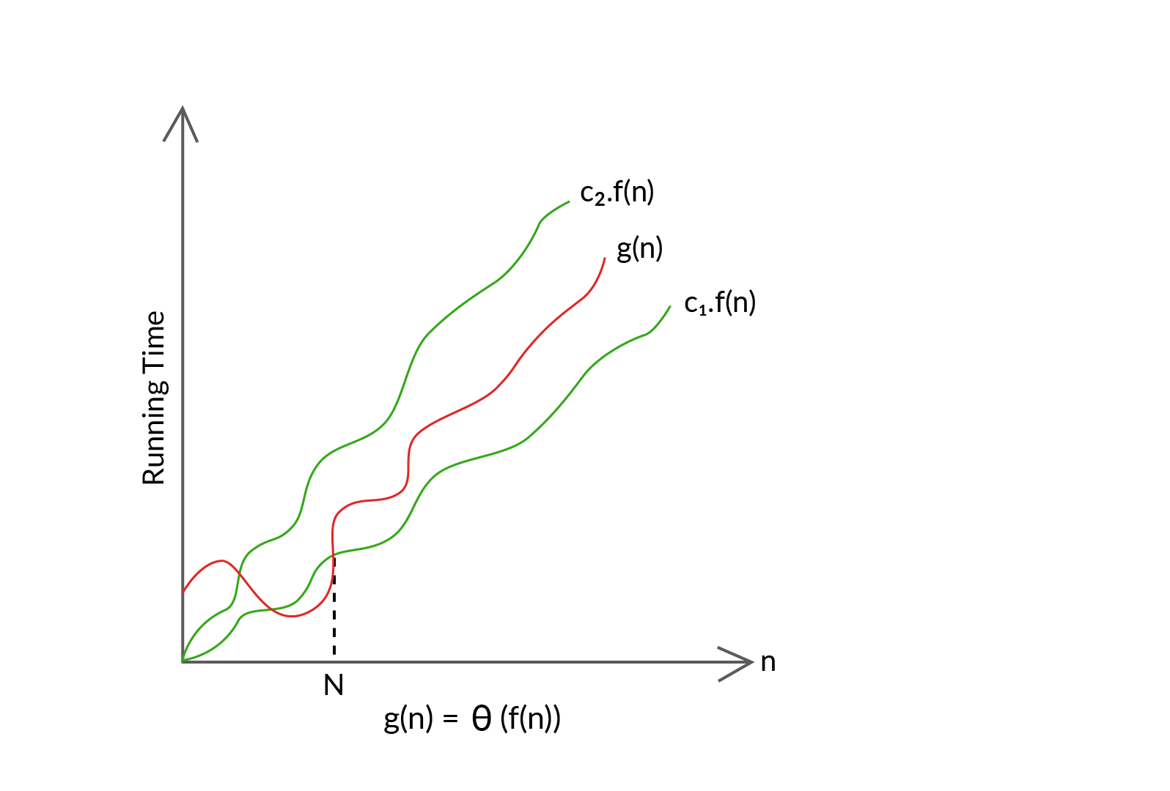
Asymptotic Notations
Big Theta(θ)
Big Theta represents an in-between case, bounded both above (upper bound) and below (lower bound) the running time of an algorithm.

Slide 16
Asymptotic Notations
Big O (Finding time complexity)
While calculating Big O of an algorithm, the following rules are used:
Rule of sums: If two loops come one after another, you need to add the number of execution steps for each loop.
Rule of products: If two loops are nested, then you need to multiply the number of execution steps for each value.

Slide 17
Asymptotic Notations
Big O (Finding time complexity)
What is the time complexity of this code snippet?
for (int i = 1; i <= n; i += 1) {
for (int j = 1; j <= n; j += 1) {
System.out.println("Hello"); }}
for (int x = 1; x <= 10; x += 1) {
for (int y = 1; y <= n; y += 1) {
System.out.println("World"); }}
Notes:
Explain the difference between time complexity equation and Big O function with the given example.

Slide 18
Asymptotic Notations
Big O(Special Cases)
You have learnt how to find the time complexity of an algorithm. Let’s see if you can find the time complexity of these code segments:
Case 1: for (int a = 1; a <= n; a *= 2) {
System.out.println("case1"); }
Case 2: for (int b = n; b > 0; b = sqrt(b)) {
System.out.println("case2"); }
Case 3: void case3( int n){
for (int c = 0; c < n; c++) {
case3(n - 1); }}
Notes:
Case 1: O(log₂n) Case 2: O(log₂(log₂n)) Case 3: O(n!)

Slide 19
Asymptotic Notations
Big O Functions
What do you think will happen if we double the size of input ‘n’ in an algorithm with time complexity of O(n)?
What about if it was O(n²)?
Or O(n³)?
Can you visualize the amount of time it will take if the input size is somewhere around a few higher order of 10?

Slide 20
Asymptotic Notations
Big O Functions
We have seen the most frequently encountered asymptotic notations:
O(n), O(n²), O(n³), O(logn), O(1), O(n logn), O(n!), O(2^{n})
Now, can you arrange these big O functions in order of their increasing efficiency?
(Hint: Take any arbitrary value for n which moderately high and then solve)

Slide 21
Asymptotic Notations
Big O Functions
The correct answer is:
O(n!) < O(2^{n}) < O(n³) < O(n²) < O(n logn) < O(n) < O(logn) < O(1)
Now can you arrange the following too in the above order?
O(√n),
O(log(log n)),
O(logn)

Slide 22
Time Complexity Vs Space Complexity
As a software developer, you’ll often face this kind of dilemma when designing programs and creating software.
Do you want to write programs that run fast but use lots of memory space?
Or, do you want to write programs that use less memory space but run slower?

Slide 23

Time Complexity Vs Space Complexity
Let’s see a few scenarios where we would have to choose either speed or memory efficiency over the other.
If you are creating a piece of software to perform high-frequency stock trading where every microsecond is important for massive gains or losses, which trade off is acceptable?
Image id: 1573180120

Slide 24

Time Complexity Vs Space Complexity
If you are creating a piece of software that runs on smartphones, where the memory allocated to the software is limited, then?
Image id: 195466427

Slide 25
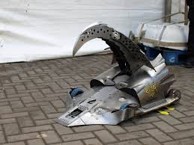
Time Complexity Vs Space Complexity
What about a robot for robot wars where the memory availability is scarce, but quick movements and reactions are important too?
Balance becomes very crucial here.
Therefore, use your best judgement when it comes to ‘Time vs Space Complexity’ trade-offs.

Slide 26

Image id: 1035282343

Slide 27
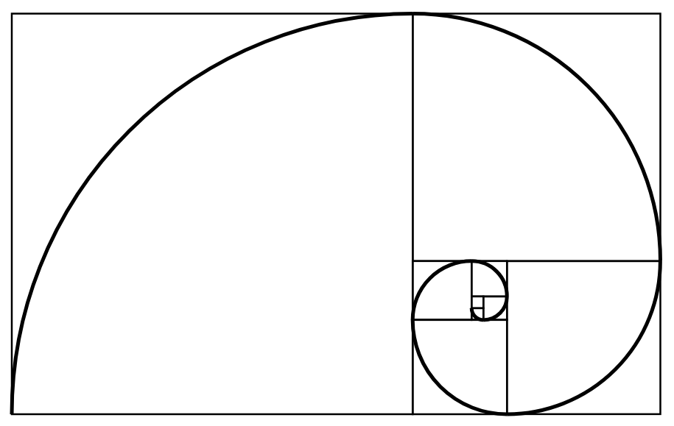
Fibonacci Sequence
We all are amused by spirals, aren’t we?
Can you find the pattern in this spiral?
What will be the value for the last part?
21
?
5
3
1
1
2
13
8

Slide 28
Fibonacci Sequence
The spiral is called the Fibonacci Spiral and the sequence is called the Fibonacci Sequence. Just like you guessed, the value of a Fibonacci number is the sum of the previous two numbers in the sequence starting with 0 and 1.
Here are the first few numbers:
0, 1, 1, 2, 3, 5, 8, 13, 21, 34, 55, 89, 144, 233, 377, 610,…..
Can you find the next two numbers?

Slide 29
Fibonacci Sequence
Similarly, F(50) = 12586269025,
F(100) = 354224848179261915075
As we can clearly see, the Fibonacci number for 100 is a big value, what will be the size of Fibonacci number for higher orders of 10?
The time taken to find the actual Fibonacci values for higher orders of 10 is huge.
Therefore, for our convenience, we will use the following function instead:
F(n) = [F(n - 1) + F(n - 2)]%10

Slide 30
Recursion
Recursion is a method of solving a problem where the solution is derived from the smaller instances of the same problem. In layman terms, recursion involves calling a certain procedure within itself.
In programming, it is defined as the technique where a function calls itself several times.
One of the most common uses of the technique is to find factorial of a number. Let’s look at the code of the same:

Slide 31
Recursion
import java.util.Scanner;
public class Demo {
public static int factorial(int n) {
if (n == 0)
return 1;
else
return n * factorial(n - 1); }
public static void main(String args[]) {
Scanner sc = new Scanner(System.in);
System.out.println("Enter a positive no: ");
int n = sc.nextInt();
System.out.println("Factorial of "+n+" is "+ factorial(n)); }}

Slide 32

Algorithm 1
Now that you know the concepts of recursion, we can return back to solving our custom Fibonacci function. Here’s one approach using our newly learnt concepts:
public int fibonacci(int n) {
if (n < 2)
return n;
else
return (fibonacci(n - 1)+
fibonacci(n - 2))%10;
}
Image id: 778407028

Slide 33
Algorithm 1
See how easy can a problem become with the help of recursion?
Now let’s look at the time and space complexity analysis of the code:
Notes:
T(n) ∈ O(2^{n}) – Exponential time, S(n) ∈ O(n) – Linear space

Slide 34

Algorithm 2
Can the same problem be solved using looping instead of recursion? Let’s have a look:
public int fibonacci(int n) {
int[] f = new int[n+1];
f[0] = 0;
f[1] = 1;
for(int i=2;i<=n;i++)
f[i]=(f[i-1]+f[i-2])%10;
return f[n]);
}
Image id: 795272986

Slide 35
Algorithm 2
Does this algorithm seem more efficient than the other? Let’s analyse the complexities:
Do you think this algorithm will work for all values of n?
Notes:
T(n) ∈ O(n) – Linear time S(n) ∈ O(n) – Linear space

Slide 36

Algorithm 3
Can there be another way to overcome the space complexity challenge? Let’s see:
public int fibonacci(int n) {
int a = 0, b = 1, c = n;
for (int i=2; i<=n; i++){
c = (a + b)%10;
a = b;
b = c;}
return c;
}
Image id: 294105158

Slide 37
Algorithm 3
What about the time and space complexity of this algorithm?
Can we say it is better than the other two algorithms?
Notes:
T(n) ∈ O(n) – Linear time S(n) ∈ O(1) – Constant space

Slide 38
Comparing the 3 Algorithms
Let’s compare all the algorithms together once:
Clearly, Algorithm 3 is better than the other two when it comes to time and space complexities.
Algorithm | Method | Time complexity | Space complexity
1 | Recursion | O(2^{n}) – Exponential time | O(n) – Linear space
2 | Loops | O(n) – Linear time | O(n) – Linear space
3 | Space efficient | O(n) – Linear time | O(1) – Constant space

Slide 39
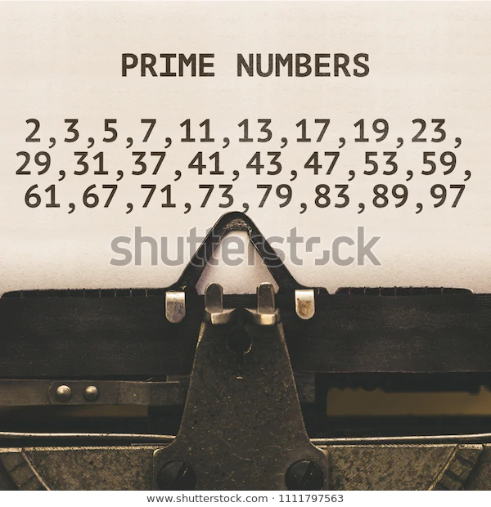
Prime Numbers less than N
Now let’s look at another problem.
You have to print all the prime numbers less than or equal to a given number N.
What’s the first approach that comes to your mind?
The simplest approach will be checking if every number less than or equal to n is prime or not and printing the prime number(s).
But how to check if a number is prime or not?
Image id: 1111797563

Slide 40

Prime Numbers less than N
Again, the basic approach is to visit each number in the range [2, n) to check if there exists a divisor which divides the number n completely.
If it exists, n is not prime. Otherwise, n is a prime number.
But do we really need to go till n for each primality check?
Image id: 1378218386
Notes:
Explain how time complexity changes from n to √n

Slide 41
Prime Numbers less than N
What if we check till √n?
Will it affect the result?
More importantly, will it affect the time complexity?
Is there any other way?
Did you know we can write every prime number in the form of 6k±1?
Can we use this fact to further reduce the number of iterations in the primality check?
Notes:
Explain how time complexity changes from n to √n

Slide 42
Prime Numbers less than N
Let’s look at the function which uses the same principle:
{
if (n <= 1) return false;
if (n <= 3) return true;
if (n % 2 == 0 || n % 3 == 0) return false;
for (int i = 5; i * i <= n; i = i + 6)
if (n % i == 0)
return false;
return true;
}
Notes:
Explain derivation of 6k+-1

Slide 43
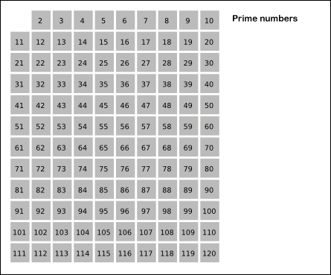
Prime Numbers less than N
Well, there’s another approach to do the same, and this one has a name too. It’s called Sieve of Eratosthenes. Click on the image to learn the logic!
boolean[] prime =new boolean[n+1];
Arrays.fill(prime, true);
for (int i=2; i<= n; i++)
if (prime[i])
for(int j=2*i;j<= n;j+=i)
prime[j] = false;
Wanna take a shot at finding the time complexity of this one?
Notes:
Explain the algo (gif) in detail and also how to find out the time complexity(n*log(log n))

Slide 44

Two people meet each other
It’s time to write your own code. Are you ready?
Problem
You will be given starting points of two people p1 and p2 respectively, and the distance covered by two people in each jump is s1 and s2 respectively.
You need to find whether they meet after the same number of jumps from their starting points.
The starting points of the two persons should always be different.
Image id: 538723513
Notes:
Explain the approach students should prefer before the coding begins

Slide 45
Two people meet each other
Input
The first line should be the values of p1, p2 respectively space-separated.
The first line should be the values of s1, s2 respectively space-separated.
Output
Print “YES” if they meet at some point after jumping for an equal number of times or else print “NO”.
Example: Input Output
6 8 YES
3 2
Happy Coding!!!
Notes:
Explain the approach students should prefer before the coding begins

Slide 46
#LifeKoKaroLift
Thank You!

